Slide 1
Recap of Class 9
History of congressional control over executive branch organization
Introduced debate over unitary executive theory/theories
Appointments
  One method for principal officers; four options for inferior officers
  Officers exercise “significant functions pursuant to public law” - Buckley

Slide 2
Puzzles of Buckley
If the agency were limited to rulemaking and quasi-adjudicative functions – i.e., none of its administrative activity was law enforcement of a traditionally executive kind – would the Court have come out the other way?
  No -- the Court does not test powers by their “nature” in some abstract sense
  The test = are the powers under discussion powers that Congress could have delegated to one of its own committees?
Why – given that the Appointments provisions of Article II do not explicitly refer to themselves as “exclusive” – does Court insist that Congress may not authorize appointment of officers of the United States through any other method?
  Constitution intends separation of legislation and administration
  Also refers to Incompatibility Clause to frame the point

Slide 3
U.S. Civil Rights Commission
Investigate complaints of voting rights violations
Study and issue analyses of legal developments in civil rights law
Study efficacy of current law in protecting civil rights
National clearinghouse for civil rights information
Hire a staff
Set up advisory committees in the 50 states to report to the commission
Hold public hearings
Issue subpoenas for attendance at such hearings, which the Comm’n may ask the AG to enforce by going to court

Slide 4
Officers or Employees?
Freytag (1991) – Special Trial Judges of the U.S. Tax Court hold statutory positions that perform more than ministerial tasks involving significant discretion (153)
Lucia (2018) – ALJ’s working for the Securities and Exchange Commission are officers

Slide 5
Principal or Inferior?
“We need not attempt here to decide exactly where the line falls between the two types of officers . . .[A]ppellant is subject to removal by a higher Executive Branch official. . .Second, appellant is empowered by the Act to perform only certain, limited duties. . . .[T]his grant of authority does not include any authority to formulate policy for the Government or the Executive Branch . . .Third, appellant's office is limited in jurisdiction.” [171]
Morrison v. Olson, 487 U.S. 654, 671–72 (1988).

Slide 6
“Inferior Officer” Cases
Edmond v. United States, 520 U.S. 651 (1997): Court unanimously (through an opinion by Justice Scalia) upholds the appointment by the Secretary of Transportation of civilian members of the Coast Guard Court of Criminal Appeals; invoked formal test, but would also pass balancing
Fair Enterprise Fund v. Public Company Accounting Oversight Board, 130 S.Ct. 3138 (2010) – Follows Edmond test in deciding whether PCAOB members are “inferior officers”

Slide 7
U.S. v. Arthrex (2021)
Why is there an issue whether the Secretary of Commerce may appoint PTAB members?
Director of Patent and Trademark Office
(Appointed by POTUS w/ A & C):
Decides Whether to Hold Inter Partes review
Designates APJs to conduct review
Patent Trial and Appeals Board
(Appointed by Secretary of Commerce
Except for PTO Director):
Conducts Inter Partes review
Final orders appealable to Federal Circuit

Slide 8
PTAB Functions
Conduct inter pares review – adjudication whether original patent actually satisfied the novelty and nonobviousness conditions
Anyone can trigger a review, including the Director, who designates three judges
PTAB issues a decision; disappointed party may ask for rehearing
Director can intervene on judicial review to support or oppose ruling

Slide 9
Arthrex Holdings
“The Director …is the boss, except when it comes to the one thing that makes the APJs officers exercising “significant authority” in the first place—their power to issue decisions on patentability.” 160
“Review outside Article II—here, an appeal to the Federal Circuit—cannot provide the necessary supervision.”
  “Many decisions by inferior officers do not bind the Executive Branch to exercise executive power in a particular manner, and we do not address supervision outside the context of adjudication.”
“[R]egardless whether the Government is correct that at-will removal by the Secretary would cure the constitutional problem, review by the Director better reflects the structure of supervision within the PTO and the nature of APJs’ duties.”

Slide 10
SCOTUS’s Normative Theory
“Today, thousands of officers wield executive power on behalf of the President in the name of the United States. That power acquires its legitimacy and accountability to the public through ‘a clear and effective chain of command’ down from the President, on whom all the people vote. Free Enterprise Fund, 561 U. S., at 498.” [158]

Slide 11
Legitimacy
Two faces of legitimacy: Popular legitimacy/ “moral” legitimacy
Potential sources of administrative legitimacy
  Electoral connection to POTUS
  Fidelity to statutory command
  Procedural fairness
  Soundness of decision making
  “[R]esponsiveness to evolving circumstances and public inputs on the ground, not just or even primarily to center-directed mandates”

Slide 12
Dissents
Gorsuch: Remedy should just be throwing out the decision affected
Breyer with Sotomayor and Kagan: Congress had adequate functional justification to design the PTAB as it did
Thomas with Breyer, Sotomayor, Kagan: APJs are supervised and directed by superiors; don’t become principal officers because of the decisions they make

Slide 13
Where the Court Leaves Us
“Inferior” officers are supervised and under the direction of principal officers
  An officer whose decision making binds the executive branch as its final position is not “inferior”
Persons working for the government who are not “officers” are employees – Congress may provide for their hiring through any N & P process

Slide 14
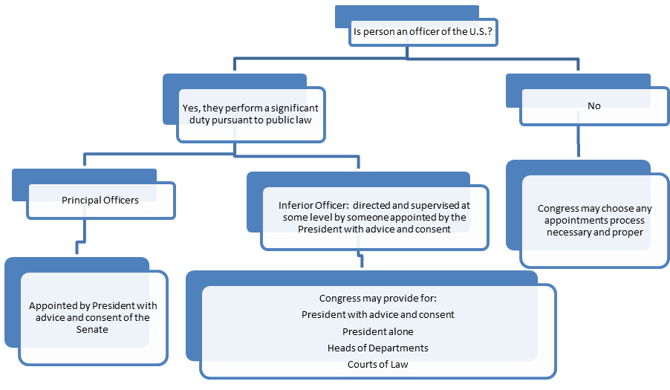
Appointments Clause Flow Chart

Slide 15
Interbranch Appointments
“T]here was little or no debate on the question whether the Clause empowers Congress to provide for interbranch appointments, and there is nothing to suggest that the Framers intended to prevent Congress from having that power.
“We do not mean to say that Congress' power to provide for interbranch appointments of “inferior officers” is unlimited. . . . Congress' decision to vest the appointment power in the courts would be improper if there was some “incongruity” between the functions normally performed by the courts and the performance of their duty to appoint.” Morrison v. Olson, 487 U.S. 654, 675–76 (1988).

Slide 16
Debating the Point https://constitutioncenter.org/the-constitution/articles/article-ii/clauses/346
Shane: “There is no textual bar to interbranch appointments and, contrary to some originalist claims, the boundary between executive and judicial power was highly uncertain in 1787.”
McGinnis: “[P]ermitting interbranch appointments presents two unpalatable choices. One possibility would be to allow Congress to authorize the judiciary to appoint all inferior officers in the executive branch, thereby depriving the President of the personnel necessary to implement policy and hollowing out his constitutionally assigned responsibility to take care that the laws be faithfully executed. The other possibility would be to let the judiciary decide for itself how far such appointment power should extend, without any constitutional standard to guide its discretion. Either path would transfer control over the executive branch to a body insulated from electoral accountability.”

Slide 17
“Independent Agency”
What traditionally made the agency “independent” is that the head(s) of the agency were protected by statute against removal at will; agency statute provides – either explicitly or implicitly -- that they may be removed only for good cause (inefficiency, neglect of office, malfeasance)
Usual reading: Not good cause for firing that the agency head(s) and the President simply disagree over policy

Slide 18
“Independent” v. “Executive” Agencies
Different statutory organizations, but:
  No uniformity in removal positions
  No principled distinction in functions
  Politics can always be surprising

Slide 19
Removals: Myers and
Humphrey’s Executor
Myers: Court invalidated a law that required the President, in firing postmasters of the United States, to get the Senate’s Advice and Consent
Like the Tenure in Office that led to Johnson impeachment

Slide 20
Historical Argument:
Decision of 1789
Change in bill to create the Department of Foreign Affairs from:
[T]here shall be established . . . the Department of Foreign Affairs, at the head of which there shall be an officer . . . to be removable by the President.
To:
[T]here shall be an inferior officer . . . who, whenever the said principal officer shall be removed from office by the President of the United States, or in any other case of vacancy, shall during such vacancy have the charge and custody of all records, books, and papers appertaining to said Department.

Slide 21
Four Positions in House
Impeachment was sole removal avenue
Removal power follows appointment power – if Senate involved in one, then also the other
Sole presidential removal OK if approved by Congress
Article II vests plenary removal power in POTUS

Slide 22
Senate
Madison probably went with weaker clause to avoid saying explicitly that the Senate had no removal power
Senate split 10-10 on the weaker language!
Explored by Prof. Jed Shugerman’s review of Sen. Maclay diaries

Slide 23
The Vesting Argument
“The ordinary duties of officers prescribed by statute come under the general administrative control of the President by virtue of the general grant to him of the executive power, and he may properly supervise and guide their construction of the statutes under which they act in order to secure that unitary and uniform execution of the laws which article 2 of the Constitution evidently contemplated in vesting general executive power in the President alone.” [183]

Slide 24
The Functional Argument
“Made responsible under the Constitution for the effective enforcement of the law, the President needs as an indispensable aid to meet it the disciplinary influence upon those who act under him of a reserve power of removal.” (182)
  Political functions
  “Normal” statutory functions

Slide 25
Quasi-Adjudicative Officers
“[T]there may be duties so peculiarly and specifically committed to the discretion of a particular officer as to raise a question whether the President may overrule or revise the officer's interpretation of his statutory duty in a particular instance. Then there may be duties of a quasi judicial character imposed on executive officers and members of executive tribunals whose decisions after hearing affect interests of individuals, the discharge of which the President cannot in a particular case properly influence or control. But even in such a case he may consider the decision after its rendition as a reason for removing the officer, on the ground that the discretion regularly entrusted to that officer by statute has not been on the whole intelligently or wisely exercised.” (183)

Slide 26
Dicta on the Civil Service
“The power to remove inferior executive officers, like that to remove superior executive officers, is an incident of the power to appoint them, and is in its nature an executive power. The authority of Congress given by the excepting clause to vest the appointment of such inferior officers in the heads of departments carries with it authority incidentally to invest the heads of departments with power to remove. It has been the practice of Congress to do so and this court has recognized that power.” [183]

